Slide 1
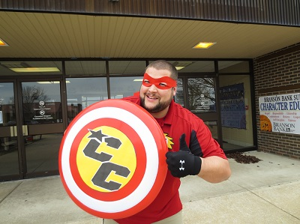
Meet Your School Counselor
COUNSELOR CODY

Slide 2
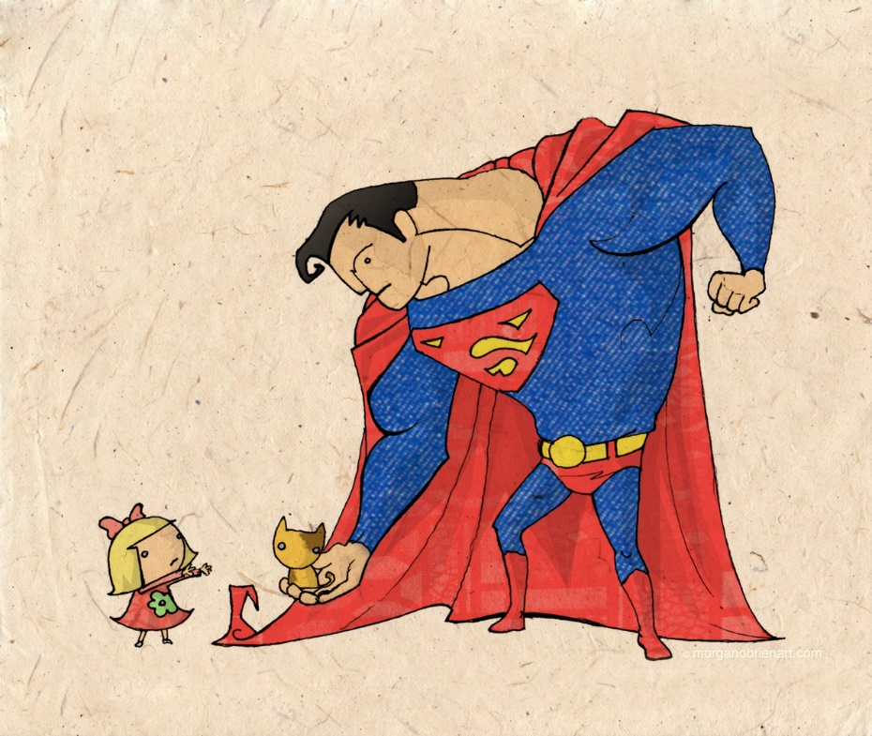
What is a school counselor?
School counselors are like superheroes! They fly around their building, helping out wherever they can.
What do they do all day?
School counselors work with students, help students, talk to parents and prepare counseling lessons.

Slide 3
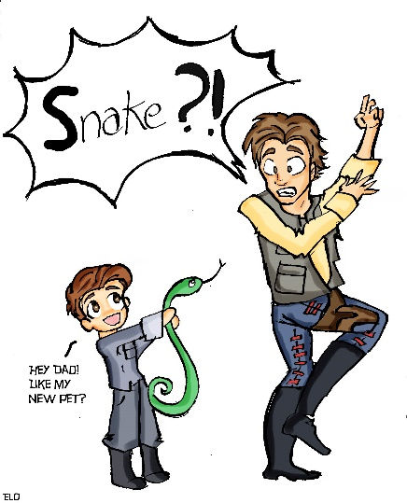
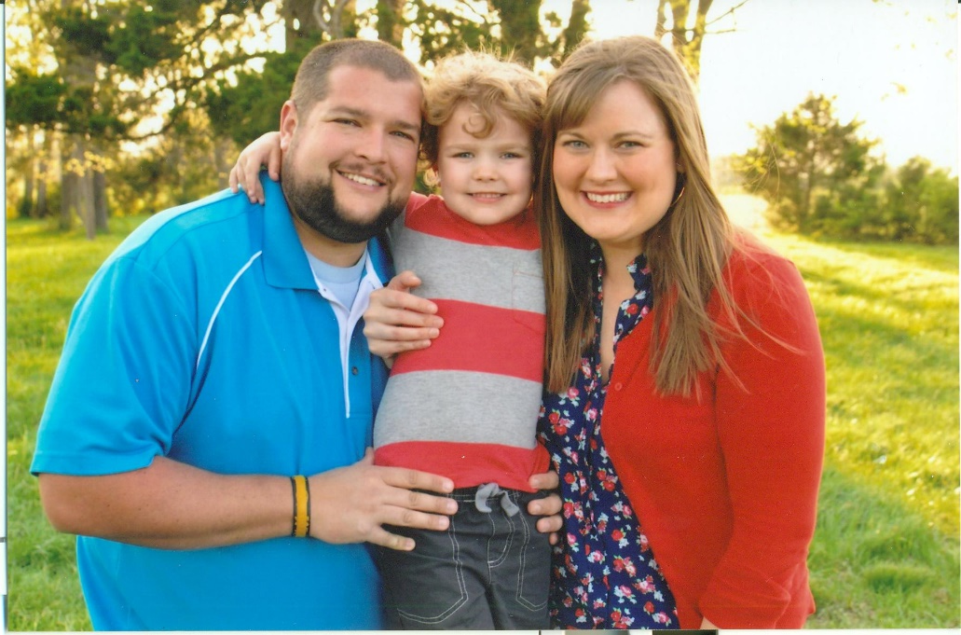
Fun facts about Counselor Cody
I LOVE all things SUPERHEROES
I have a wife and son
I am scared of snakes

Slide 4
When should you visit the school counselor…
School counselors are here to help you. If you are feeling sad, angry, confused, worried or just need someone to talk to, then let your teacher know that you would like to see the school counselor. Your teacher will let me know that you would like to speak with me.

Slide 5
Counselor cody’s toolbox
What is inside the toolbox?
Let’s take a look!

Slide 6
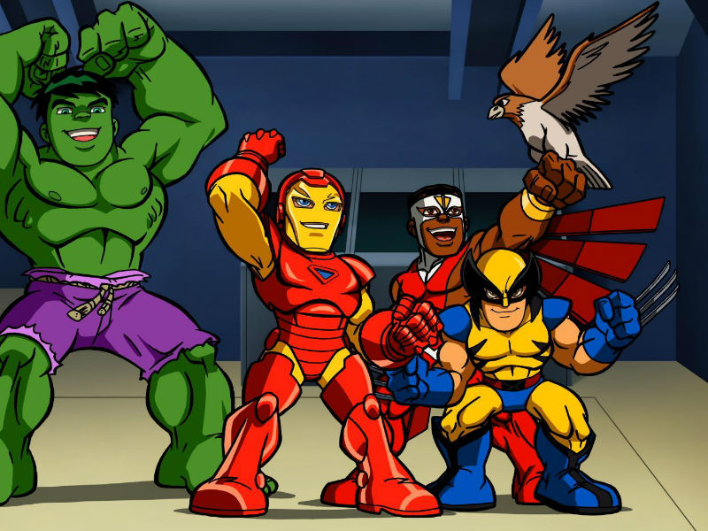
Let’s have a great year!!!

